Slide 1
FOREIGN DIRECT INVESTMENT ANALYSIS
Ansh Gupta

Slide 2
PROBLEM STATEMENT
Investment is a game of understanding historic data of investment objects under. different events but it is still a game of chances to minimize the risk we apply analytics to find the equilibrium investment.
To understand the Foreign direct investment in India for the last 17 years from 2000-01 to 2016-17. This dataset contains sector and financial year-wise data of FDI in India
Sector-wise investment analysis and Year-wise investment analysis.

Slide 3
OBJECTIVE
Find key metrics and factors and show the meaningful relationships between attributes. Do your own research and come up with your findings

Slide 4





PROCESS
Step 1
Step 2
Step 3
Step 4
Step 5
Data Collection
Data Pre-Processing
Exploratory Data Analysis (EDA)
Finding Insights
Tableau Dashboard

Slide 5
DATASET INFORMATION
This dataset includes sector-wise and financial year-wise data of FDI in India for comprehensive investment analysis from 2000-01 to 2016-17.

Slide 6
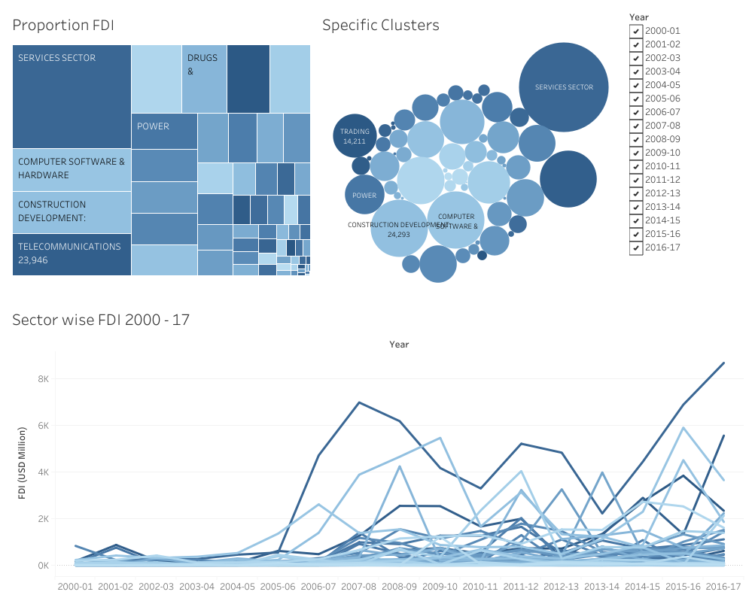

Slide 7
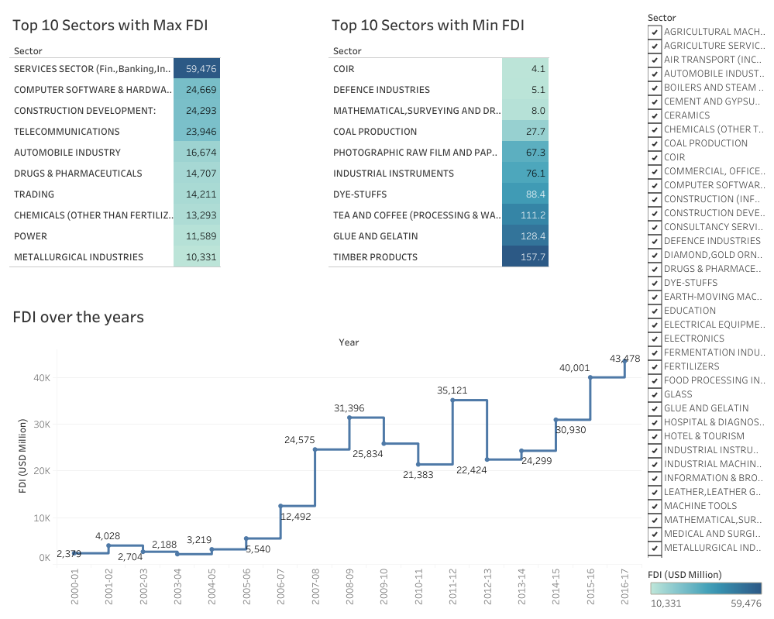

Slide 8
AREAS OF FOCUS
Sector-wise investment
Year-wise investment analysis
Service sector leads FDI inflow with 39.92%, followed by Computer Software/Hardware (17.32%), Telecommunication (16.53%), Construction (14.54%), Automobile (11.69%).
Bottom sectors: COIR (4.42%), Defense (5.33%), Instruments (8.49%), Coal (24.93%), Photographic (56.83%).
Top and bottom sector FDI inflows highlight sectoral investment disparities in India.
FDI rose from $2.3B in 2000-01 to $4.1B in 2001-02.
Significant increase in 2008-09 to $30.7B, despite fluctuations from 2010-2014.
Highest FDI inflow in 2016-17 at $62B, showing rising foreign investment in India.

Slide 9
SUMMARY
The sectoral composition of FDI in India from 2000 to 2017 reveals a dominance of the service sector, constituting 17.65% of total inflows. Foreign interest in financial services is notable for profit repatriation. Other significant sectors include computer software/hardware, construction, telecommunications, and automobiles. Despite fluctuations, FDI inflows surged to ₹291.61kCr in 2016-17, the highest in 17 years. Peak years include 2007-08 and 2015-16. Overall, the data reflects increasing foreign investment in India, favoring service sectors and demonstrating a shift in global FDI trends.

Slide 10
THANK YOU
Ansh Gupta

